Slide 1
Lab 4a: Schematic Assembly

Slide 2
Groups
You must form your groups by 2pm today.

Slide 3

What You Will Build

Slide 4
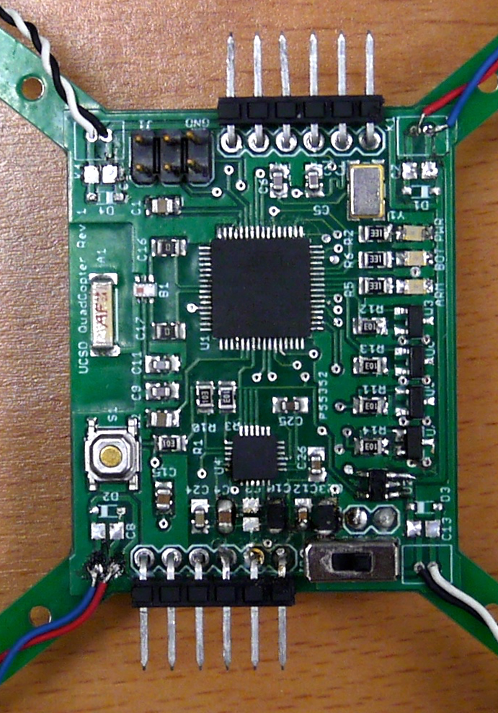
What You Will Build

Slide 5
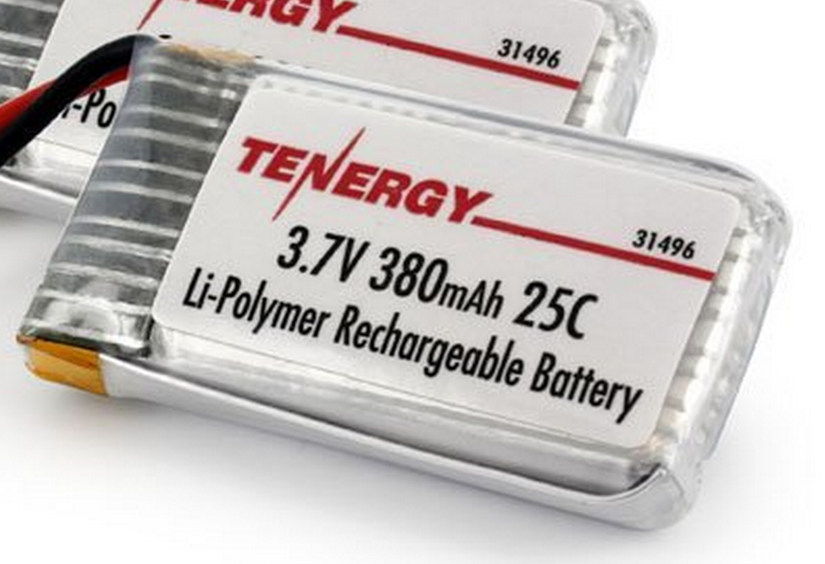
Power Supply
Lithium Polymer Battery
370 Mah
Max 9.25 Amps
Nominal voltage = 3.7V
Powers the motors directly
3.0V low dropout (LDO) voltage regulator
Powers the microcontroller and the IMU
Why 2.7 or 3V instead of 3.3V?

Slide 6
Regulator Datasheet

Slide 7
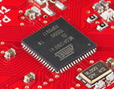
Flight Computer
ATmega128RFA1 microcontroller
Arduino compatible
16Mhz clock
128KB Flash
16KB SRAM
4096B EEPROM
2.4GHz radio (Compatible with Zigbee)

Slide 8
uController Datasheet

Slide 9
Wireless Communication
We will use a custom (i.e., designed by you) communication protocol between the controller an the quadcopter.
Why not one of the existing alternatives?
Standard RC radio protocols are analog or closed source.
Zigbee is complex and closed source.

Slide 10
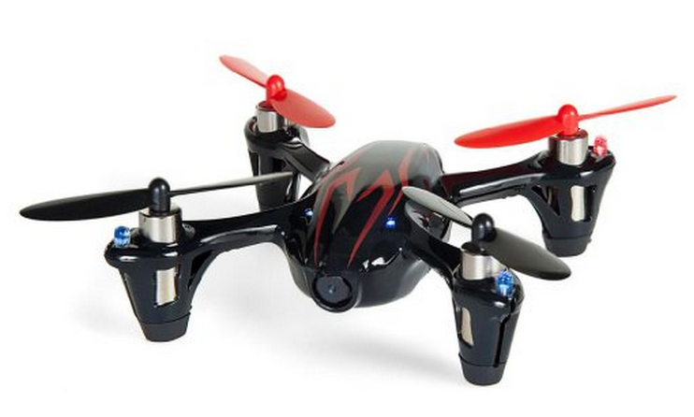
Motors and Props
Suitable motors are hard to find in small quantities.
Correct-fitting props are also a challenge
We will use motors for the Hubsan X4
Purchased as a “crash pack”
Plenty of power
DC brushed motors
They draw ~2A each.

Slide 11
Motor Driver
Pulse-width modulation (PWM)-controlled MOSFET
The microcontroller will drive the MOSFET
The MOSFET will drive current to the motor.
A diode handles the inductive load from motor when it’s off.

Slide 12
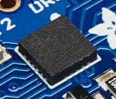
Inertial Measurement Unit
STMicro LSM9DS1
9-axis sensor
3-axis accelerometer
3-axis magnetometer
3-axis gyroscope
We will use the I2C interface

Slide 13
IMU datasheet
Notes
You can tie all the RES/GND pads to one pin on the schematic symbol

Slide 14
Inter-Integrated Circuit (I²C) Bus Interface AKA: Two Wire Interface (TWI)

Slide 15
Brief History
Designed in 1982 by Philips Semiconductor (now NXP)
1992 - First public Spec released
Since 2006 no licensing fees are required
Widely adopted technology

Slide 16
Why I²C?
Pins are precious!
They take up space
More pins → More expensive microcontrollers
Adding pins is hard
Might need a new microcontroller (if a larger, compatible one is available)
Significant board changes
Performance is often not that important
So
Use the minimum number of pins
Run them at relatively low bit rates.

Slide 17
Applications
Connecting to all kinds of small, slow peripherals
Reading Configuration data from various devices (Memory, PCI cards)
Accessing ADCs and DACs
Reading from Real-time clocks
Reading hardware monitoring devices (Fan speed, CPU Temperature, Accelerometers)
Controlling power supplies for various system components
GPIO expanders
Many, many others

Slide 18
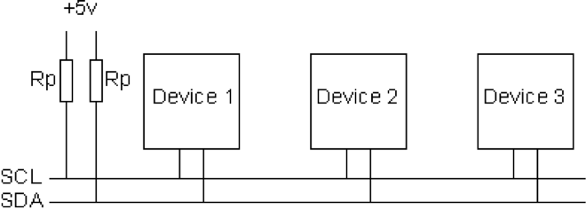
I²C Bus Architecture
Two signals
SCL – Serial Clock (used for coordination and timing)
SDA – Serial Data (used for data and control signaling)
Up to 1008 peripherals
1 or more “masters” that initiate communication on the bus
Up to 127 “slaves” that masters communicate
Bit rates
100 KHz (Standard mode)
400 KHz (Fast Mode)
3.4 MHz (High speed mode)
1 MHz (Fast Mode Plus)
5 MHz (Ultra fast mode)

Slide 19
I²C Addressing
Each slave on an I²C bus has a unique address.
Most use 7 bit addresses (we discuss this here)
An extended 10-bit version also exists
The addresses usually fixed or only partially configurable
E.g. Only the least-significant bit of the address for the IMU is settable. So you can only have two of these IMUs on one bus.
Different devices will have different numbers of settable and fixed bits.
You can’t mix components arbitrarily on the bus

Slide 20
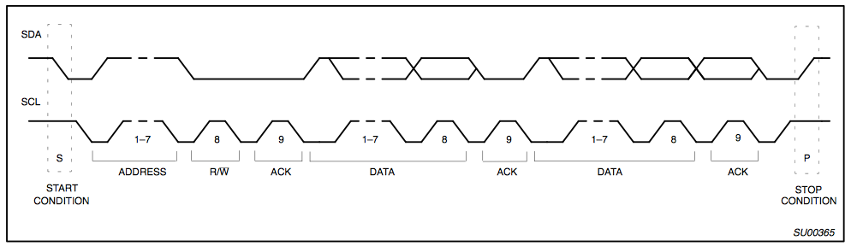
I2C Protocol - Full Xfer
Start
Philips I2C Bus Specification

Slide 21
I2C Protocol - Full Xfer
Address
R/W
Philips I2C Bus Specification

Slide 22
I2C Protocol - Full Xfer
Data
Philips I2C Bus Specification

Slide 23
I2C Protocol - Full Xfer
Stop
Philips I2C Bus Specification

Slide 24
Breakout header

Slide 25
Custom LEDs

Slide 26
Lab4b: Design Review
Once your design is complete, you are ready for your first design peer review.
Your schematic should have no errors or warnings.

